Slide 1
Outline
Motivation
Filter Type and Topologies
Insertion Loss Method
Filtering Functions
Low-Pass Prototype
Filter Transformations
Low Pass Filter
Bandpass Filter
K and J Inverters
Coupled Resonator Filter

Slide 2
Why Need Filter?
Power
Amp
Harmonics
Filter
Harmonics Suppression
Low-Noise
Amp
Filter
Signal Selection

Slide 3
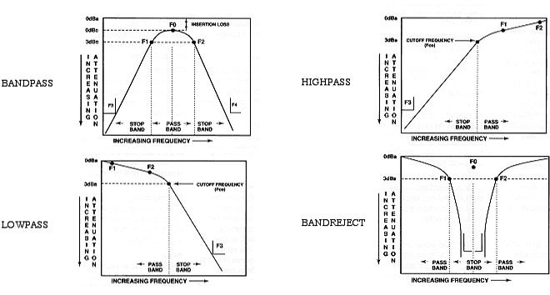
Filter Type

Slide 4
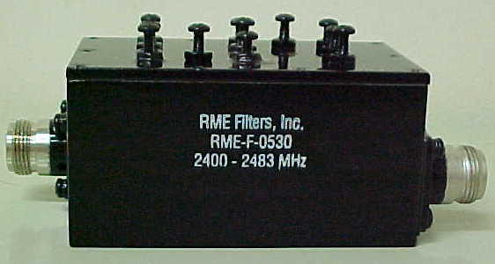
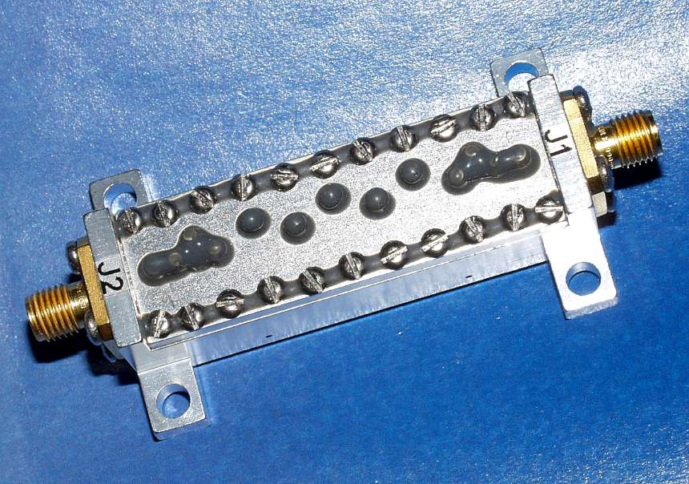
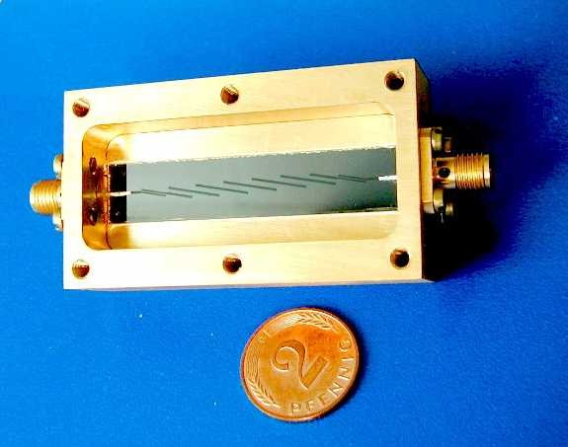
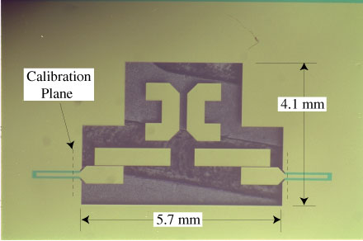
Filter Topologies
2.4 GHz Cavity Filter
Coax Filter
Microstrip Line Filter
Micromachined Filter

Slide 5

Insertion Loss Method
P_{in}
P_{Load}
ρ(ω)
Z(ω)
P_{in}
1
P_{LR}=
=
Z(ω)-Z₀
ρ(ω)
=
Even Function
P_{Load}
1-|ρ(ω)|²
Z(ω)+Z₀
M(ω²)
M(ω²)
+1
|ρ(ω)|²
P_{LR}=
=
N(ω²)
M(ω²)+N(ω²)

Slide 6
Filtering Functions
1+k² (ω/ ω_{c})^{2N}
Maximally-Flat, N section, ω_{c} Cuttoff Frequency – Slow skirt, very Smooth
1+k² T_{N}²(ω/ ω_{c})
Chebyshev – sharp response in the rejection band and has a smooth rejection skirt
P_{LR}=
…. (Use Table)
Elliptic – Sharpest response in the rejection band, but has some ripper in the rejection response

Slide 7
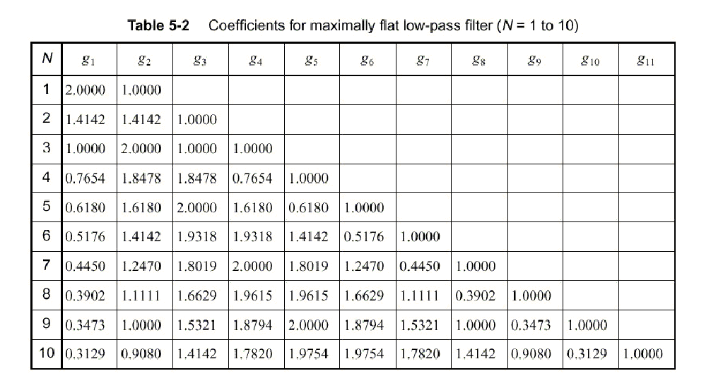
Low Pass Prototype – Maximally Flat
ω_{c}=1
Z₀=1

Slide 8
Low Pass Prototype – Maximally Flat
Figure 8.26 (p. 395) Attenuation versus normalized frequency for maximally flat filter prototypes. Adapted from G.L. Mattaei et al., Microwave Filters, Impedance-Matching Networks, and Coupling Structures (Artech House, 1980)

Slide 9
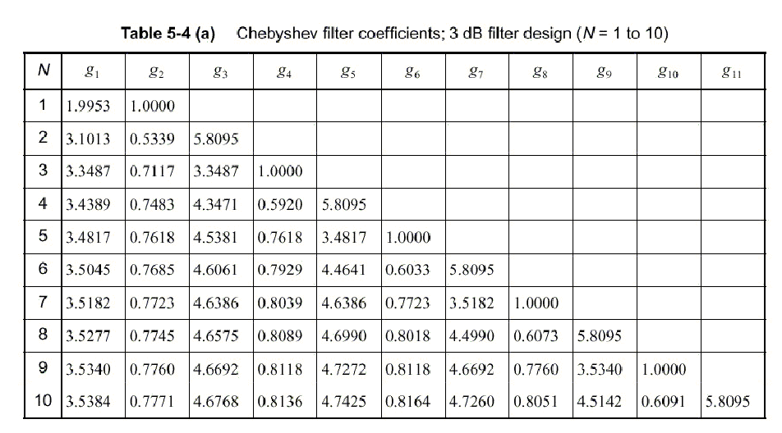
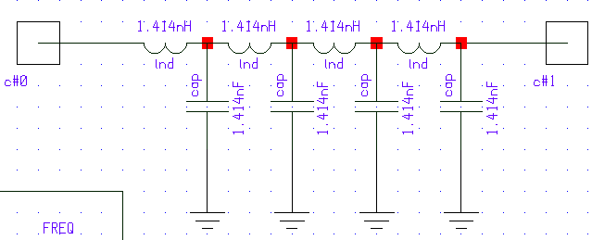
Low Pass Prototype - Chebyshev
g1
g3
g5
g7
g0
g9
g2
g4
g6
g8
Implies different port impedances for even order filter
N= 8 example

Slide 10
Low Pass Prototype - Chebyshev
Figure 8.27a (p. 397) Attenuation versus normalized frequency for equal-ripple filter prototypes. (a) 0.5 dB ripple level. Adapted from G.L. Mattaei et al., Microwave Filters, Impedance-Matching Networks, and Coupling Structures (Artech House, 1980)

Slide 11
Low Pass Prototype Chebyshev
Figure 8.27b (p. 397) Attenuation versus normalized frequency for equal-ripple filter prototypes. (b) 3.0 dB ripple level. Adapted from G.L. Mattaei et al., Microwave Filters, Impedance-Matching Networks, and Coupling Structures (Artech House, 1980)

Slide 12
Low Pass Prototype Comparison

Slide 13
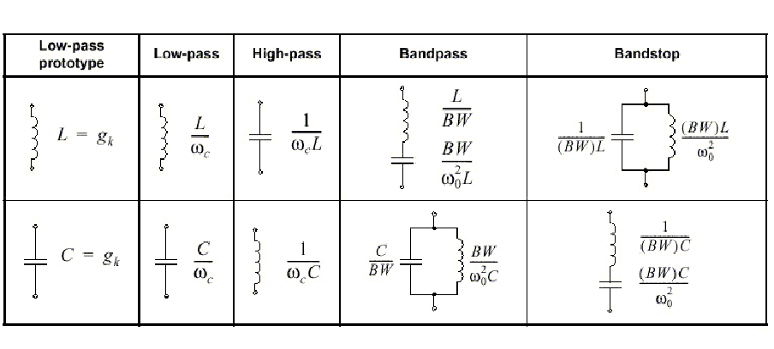
Filter Transformations
You can scale on impedance as well

Slide 14
Richard’s Transformation

Slide 15
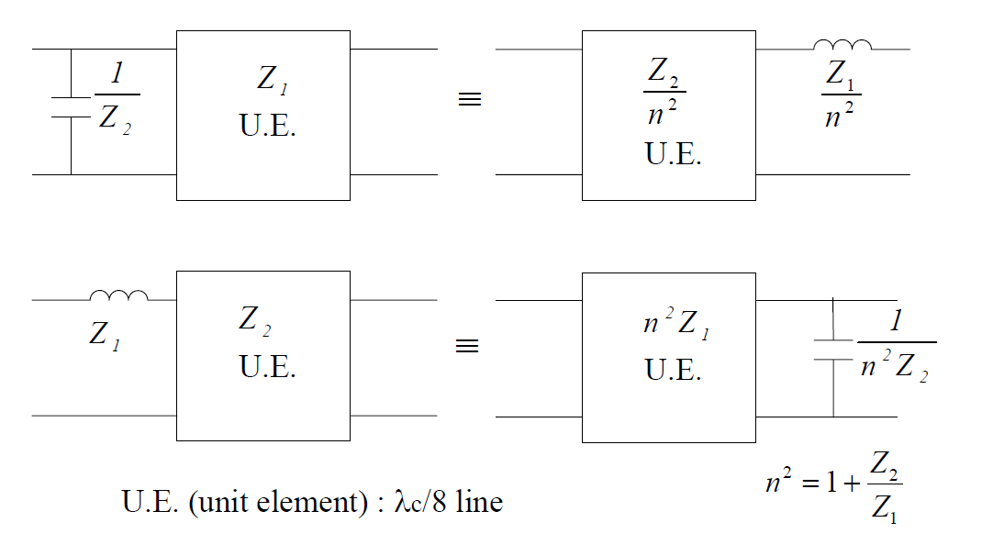
Kuroda’s Identities

Slide 16
Kuroda’s Identities

Slide 17
Low Pass Filter

Slide 18
Bandpass Filter
Impractical to realize

Slide 19
Stepped Impedance Low Pass Filter

Slide 20
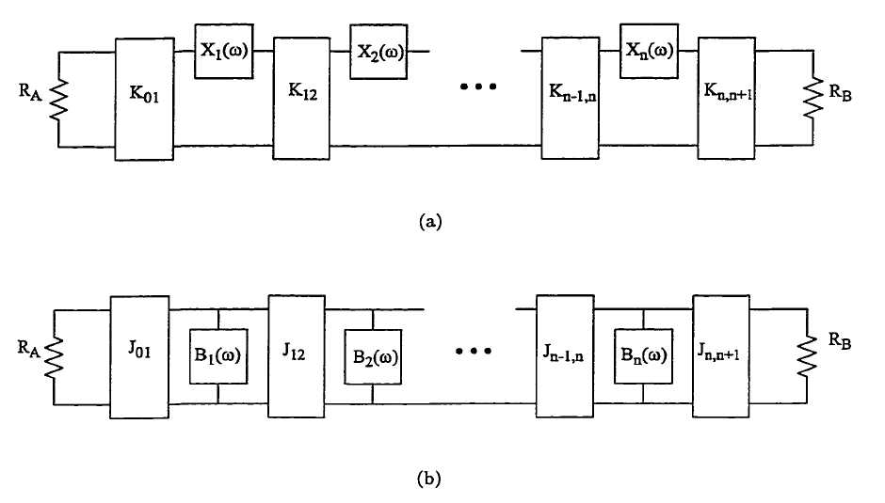
Impedance Inverter
For series RLC

Slide 21
Admittance Inverter
For shunt RLC

Slide 22
Internal Coupling Coefficient k
Circuit Model
Physics Model

Slide 23
External Coupling Coefficient Q_{ext}
Circuit Model
Physics Model

Slide 24
Coupled Resonator Filter
Ideal Inverter
Modified Inverter

Slide 25
Coupled Resonator Filter

Slide 26
Coupled Resonator Filter

Slide 27
Coupled Resonator Filter

Slide 28
Coupled Resonator Filter

Slide 29
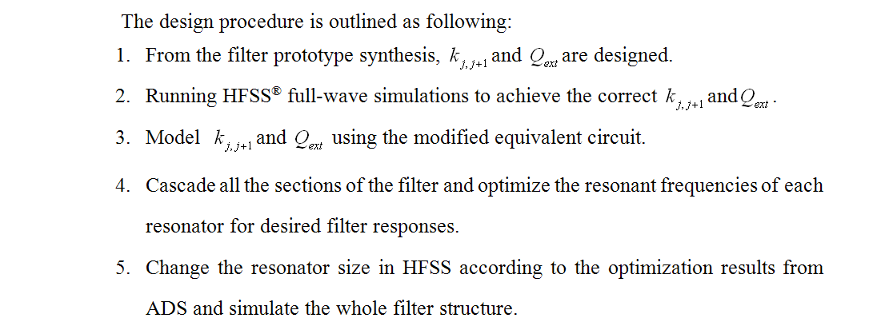
Coupled Resonator Filter

Slide 30
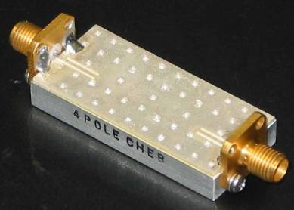
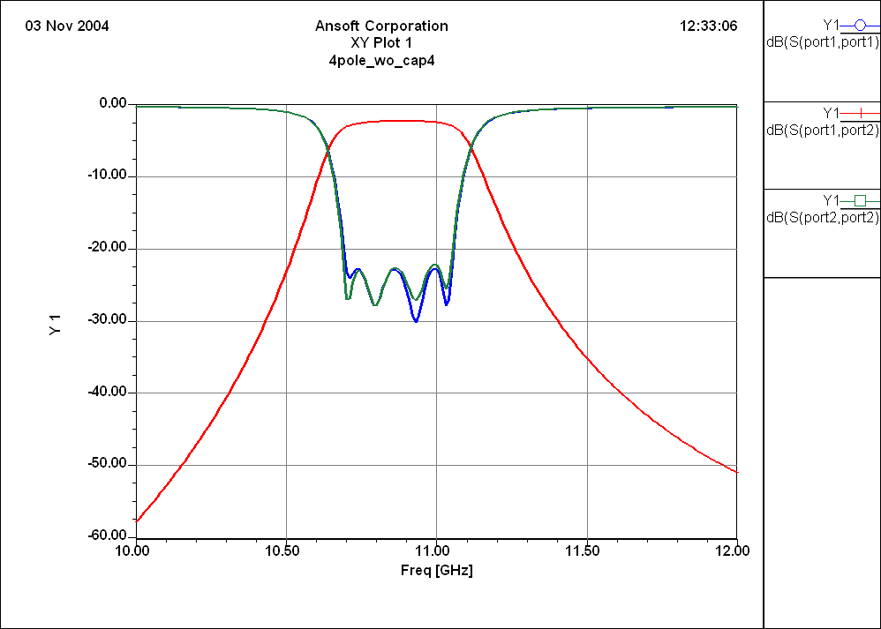
Coupled Resonator Filter

